Slide 1

Chapter 10
DATA AT SCALE

Slide 2
Goals
Provide an overview of some potential impacts of data at scale
Introduce key methods for collecting data at scale
Discuss how to make data at scale meaningful
Review the key methods for visualizing and exploring data at scale
Introduce design principles for making data at scale ethical

Slide 3
What is data at scale?
Data at scale is also known as big data
It describes numbers, images of people, places and things, conversations, video recordings, sensor data, and so on
Huge potential for solving problems
But you must know how to collect, analyze, and communicate findings
Also involves dangers to people’s privacy

Slide 4
Collecting data at scale?
Easy to collect masses of data, but then what do you do with it?
What are the rules and policies that apply when collecting data about people?
For example, tracking people’s activities as they move through Heathrow and other airports for security reasons may also violate their privacy.
Also scraping and crowdsourcing data, personal data collection directly and indirectly through devices, and sentiment and social network analysis.

Slide 5

Collecting personal data at Heathrow airport
Source: Mark Zakian / Alamy Stock Photo

Slide 6
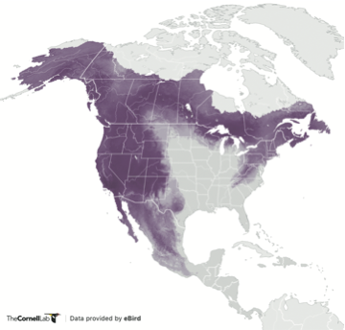
Crowdsourcing data
Clicking on this link (Common Raven) will allow you to see how the abundance of raven changes during each week of the year. (Purple indicates high abundance and yellow indicates low abundance.)
Source: eBird

Slide 7
Citizen science and privacy
Source: iNaturalist.org

Slide 8
A human data design approach to sensing data
(a) Smart Citizen’s dashboard and visualization
(b) A PhysiMove cube set up in a home
(c) The components of a Physikit tool kit
Source: (a) CitizenMe, (b) and (c) Yvonne Rogers

Slide 9
Social network analysis
US Senators voting relationships in 1989 (top), 1997 (middle), and 2013 (bottom)
Red represents Republicans and blue represents Democrats
Source: Forbes

Slide 10
Probing people’s reactions to personal tracking
Source: Courtesy of Quantified Toilets
Notes:
10

Slide 11
Students’ activity
Source: StudentLife Study

Slide 12
Activity
Source: StudentLife Study

Slide 13
Visualizing and exploring data
A simplified path for data to be meaningful
Source: Used courtesy of Dr. Artur Lugmyr

Slide 14
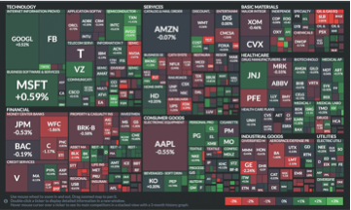
Market map of stocks
Source: Used courtesy of FINVIZ

Slide 15
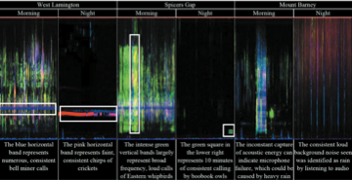
Visualization of different sounds including birds and insects
Source: Used courtesy of Oliver et al., 2018. Permission from ACM Publications.

Slide 16
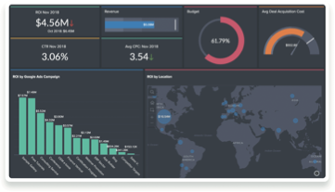
Dashboard showing changes in sales information
Source: Zoho Analytics

Slide 17
Interactive graphic using D3
Source: Reproduced with permission from PARS International

Slide 18
Exemplar dashboards
Source: Sarikaya et al., 2018. Graph 1. Reproduced with permission of IEEE.

Slide 19
Weather data
(a) Actual weather data
(b) Wundermap of data from the same area at the same time
Source: Weather Underground

Slide 20
Two different visualizations of bat call data
General visualization for the public
(b) Spectrogram for scientists
Source: (a) Used courtesy of Matej Kaninsky; (b) Used courtesy of Sarah Gallacher

Slide 21
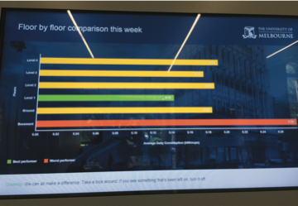
Graphical display of average daily energy consumption for a building
Source: Yvonne Rogers

Slide 22

DeepCam’s face-tracking software
Source: DeepCam

Slide 23
Data ethics principles (FATE)
Fairness: Is the treatment just and without favoritism or discrimination?
Accountability: Is the data accurate and correct?
Transparency: Are the decisions being made by a system visible?
Explainability: Can people understand the explanations provided by the system?
The goal of FATE is to make decisions made by computer systems just and fair.
Notes:
23

Slide 24
Summary
This chapter discussed how data at scale is collected, analyzed, and communicated.
The data can be qualitative or qualitative.
It comes from different sources, for example, sensors, social media, documents, and facial recognition data.
Privacy is a big concern because data from different sources can be brought together to reveal patterns of behavior.
The FATE frameworks suggests ethical principles to guide UX design: Fairness, Accountability, Transparency, and Explainability.

